Slide 1
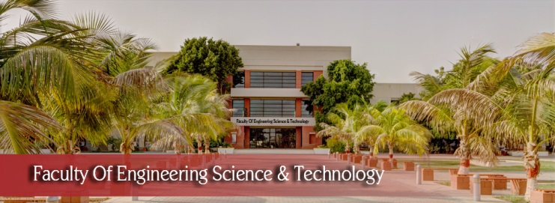

FYP-II
Innovative approaches to AI-Driven personalized Health Monitoring
Students name:
Ahtisham ul Hasnain (2606-2021)
Ifrah Waseem (1757-2021)
Hassan Iqbal(2605-2021)
(FYP-020/FL24)
Supervisor name:
Dr khuram iqbal
Department of Computing, FEST
Hamdard University

Slide 2
Summary
Introduction
Problem Statement
Project Objective
Project Scope
Architecture Big Picture
Our Methodology
Our Project Plan (Time lines)
References

Slide 3
Introduction
Group Members
Ifrah Waseem
Ahtisham ul Hasnain
Syed Muhammad Hassan Iqbal
Supervisor: DR. Khurram Iqbal
Why we selected him as supervisor?
He has already been developed/supervised couple of similar industry-academia project in the recent past, namely as “Fire Smoke Detection using CNN”and “AI based-Survellion Drone”. The project idea, problem domain, and project scope, is very much alike and related to his skills set. We believe that he can provide valuable guidance and mentorship throughout the project.
Relevant Expertise
He has experience in similar domain and industry project which is related to our project.
Relevant Experience
He has 8+ years of prolific experience in academia and IT industry.

Slide 4
Problem Statement
Current pulse rate monitoring methods often rely on bulky devices or intermittent clinical measurements, hindering seamless, real-time tracking. Emerging wearable and AI-driven technologies aim to overcome these limitations by enabling comfortable, continuous monitoring in daily life.
While current wearables enable continuous pulse monitoring, their accuracy and real-time predictive capabilities remain limited, restricting actionable health insights. Next-generation devices integrating advanced biosensors and AI-driven analytics could bridge this gap, enabling precise, proactive cardiovascular monitoring.
This gap hinders timely interventions for chronic conditions like hypertension and cardiovascular diseases.

Slide 5
Project Objective
Develop a user-friendly Mobile Application software system for accurate pulse measurement.
Implement AI for predicting health trends based on collected data.
Enable seamless data integration into existing healthcare systems.
Provide real-time and predictive health metrics via a user-friendly app

Slide 6
Project Scope
Develop a user-friendly Mobile Application Software system for accurate blood pressure and pulse measurement.
Implement AI for predicting health trends based on collected data.
Enable seamless data integration into existing healthcare systems.
Provide real-time and predictive health metrics via a user-friendly app

Slide 7
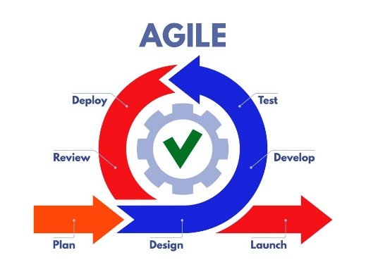
Methodology
The project will follow a structured methodology:
Data Collection and Storage: Implement protocols for data transmission to a database.
Machine Learning Model Training: Collect and preprocess data, select suitable algorithms, train and validate the models for predictive analysis.
Mob Application Development: Design and develop a responsive web interface for data visualization and user interaction.
Agile focuses on iterative development, customer centricity, and continuous adaptation through collaboration.

Slide 8
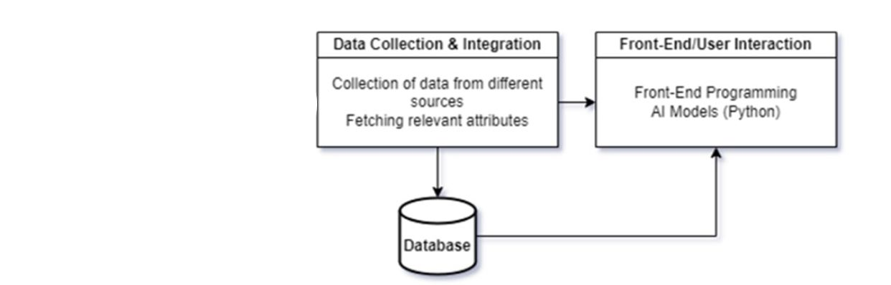
Architecture Big Picture

Slide 9
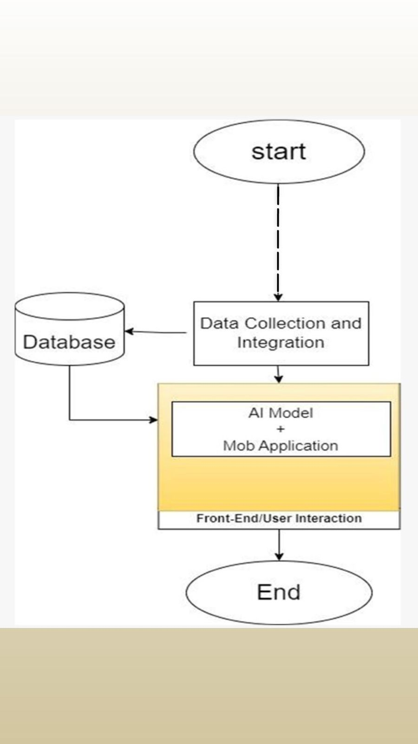
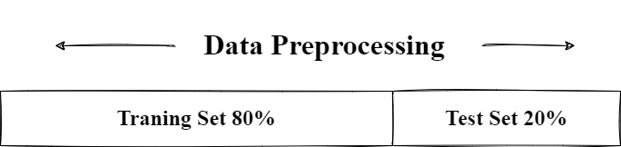
Flow of Project

Slide 10
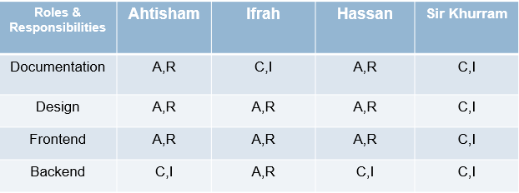
Project Role & Responsibilities
RACI Chart
- R (Responsible): Responsible for performing the task.
- A (Accountable): Ultimately accountable for the task's success.
- C (Consulted): Provides input and feedback.
- I (Informed): Kept informed about progress.

Slide 11
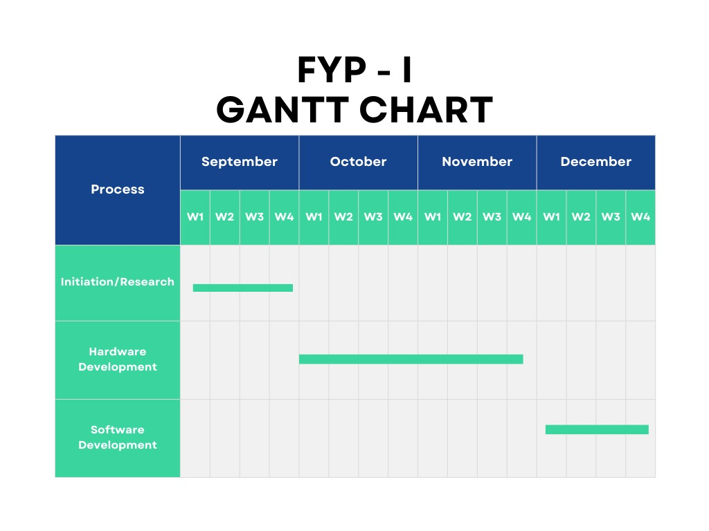
Project Plan

Slide 12
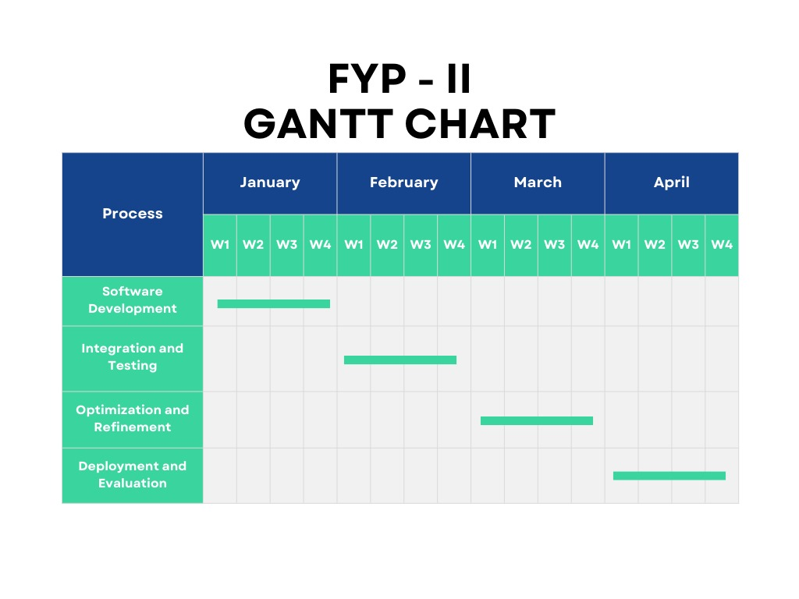
Project Plan

Slide 13
Project Budgeting
Estimated budget of project major resources
Developers (2 @ 500 x 4days x 4 week = 16000 x6 = PKR 96,800 est.)
Hard Drive (Rs. 14,000 x 2 = PKR 28,000 est.)
Industry Expert Consultancy (expected 2-4 visits) 8000 x 2 = PKR 16,000 est.
Miscellaneous PKR 11,200 est.
- Electricity (Rs. 8000 x 6 = PKR 48,000 est.)
Total cost PKR 2lac‬ est.
*Detailed budget sheet will be provide.

Slide 14
Project Tools
Software Requirements
Visual Code / colab /
Python
AI
Nodejs
React Native

Slide 15

THANK YOU!

